Slide 1

PNEUMONIA PREDICTION USING X-RAY IMAGES
Team MEMBERS
Ishani N Binu, Sheethal Krishna, Vishnu Priya,
Dinesh D, Manav Jain

Slide 2
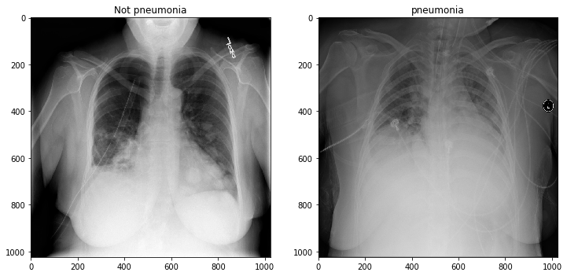
INTRODUCTION
Pneumonia is an intense respiratory disease that influences the lungs. It is a lethal disease wherein the air sacs get loaded up with discharge and other fluid. Pneumonia is ranked eighth in the list of the top 10 causes of death in the United States.

Slide 3
Limitations
Clinical interpretations of model parameters are difficult.
Sharing an existing ANN model is difficult.
Prone to overfitting due to the complexity of model structure.

Slide 4
Proposed work and methodology
This project is about building a web application that can determine a patient to have pneumonia effectively by breaking down its X-ray picture. A productive model for the recognition of pneumonia prepared on advanced chest X-ray pictures is proposed, which could help the radiologists in their dynamic interaction.

Slide 5
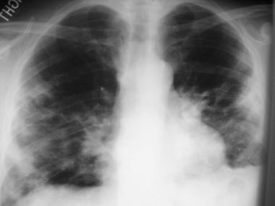
Novelty
The application of CNN in Pneumonia detection using X-RAYS assists us with using different libraries present to help identify the severity of pneumonia that correlates to the degree of Chest X-RAY (CXR) lung image abnormality.

Slide 6
Real time usage
The analysis of X-RAYS using CNN is right now being utilized at different clinical establishments including Singapore’s Changi General hospital (desktop application i.e., installed on radiology workstations) etc...

Slide 7
Hardware software designing
Hardware requirements: Laptop
Software requirements: Python-3.6, Keras, TensorFlow, Jupyter Notebook

Slide 8
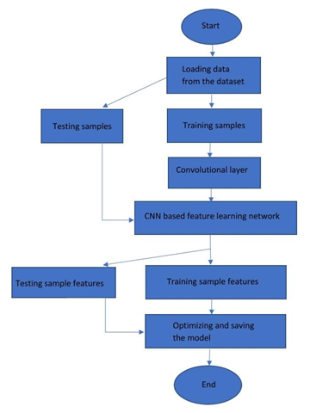
Flowchart

Slide 9
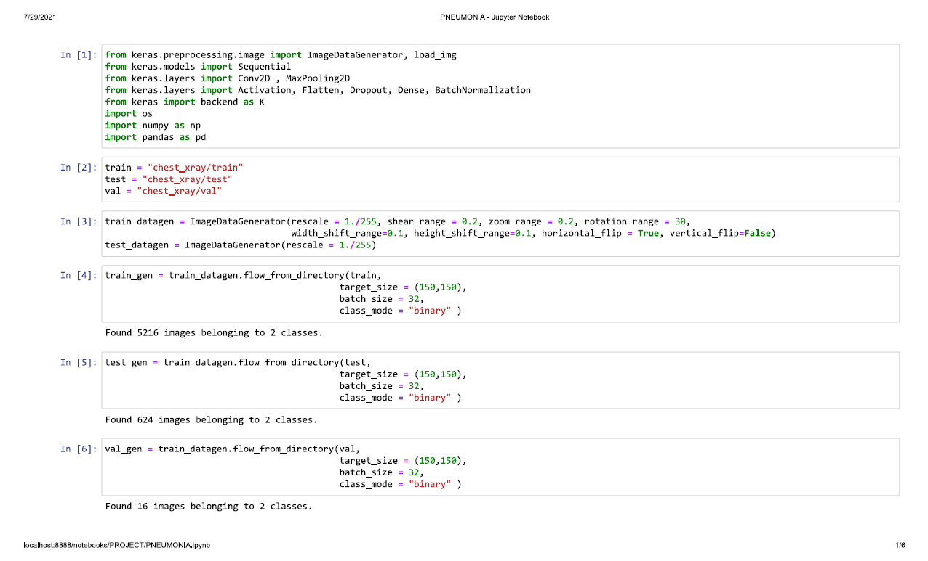
CODE

Slide 10
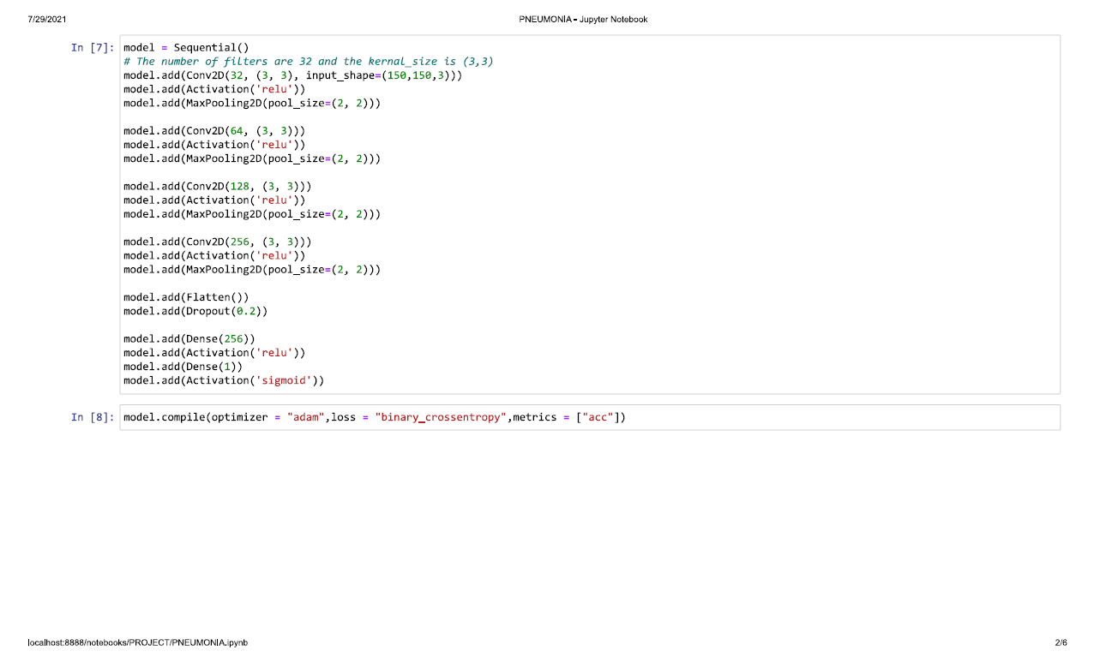

Slide 11
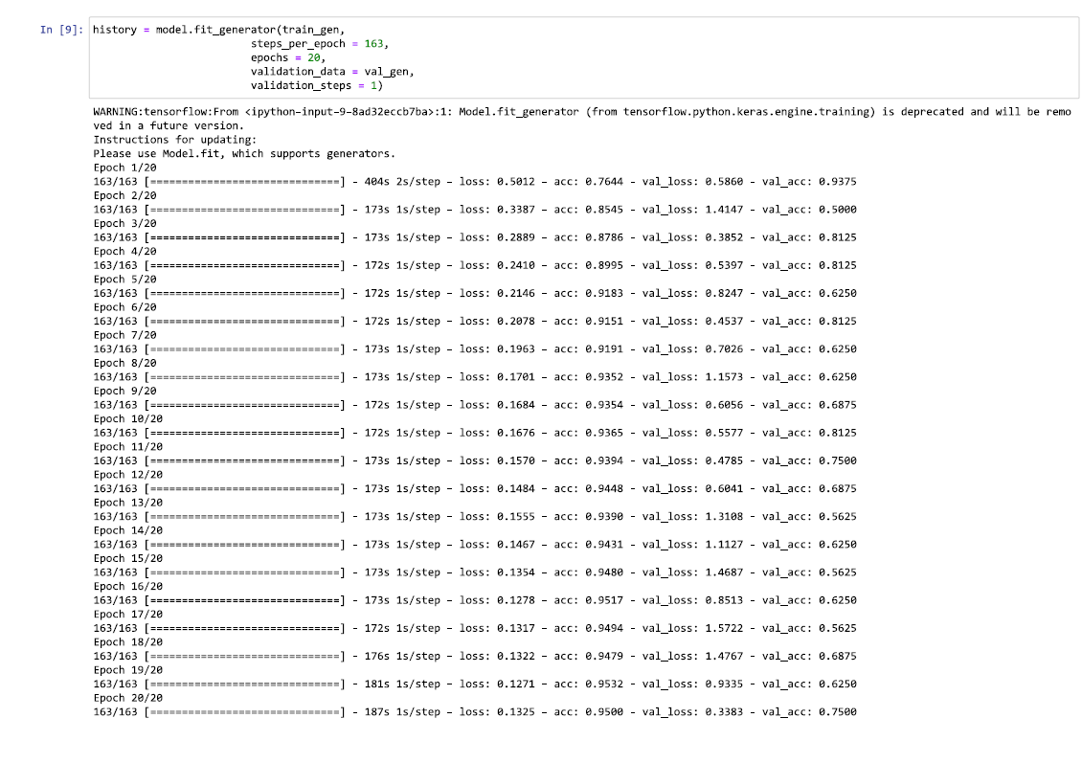

Slide 12
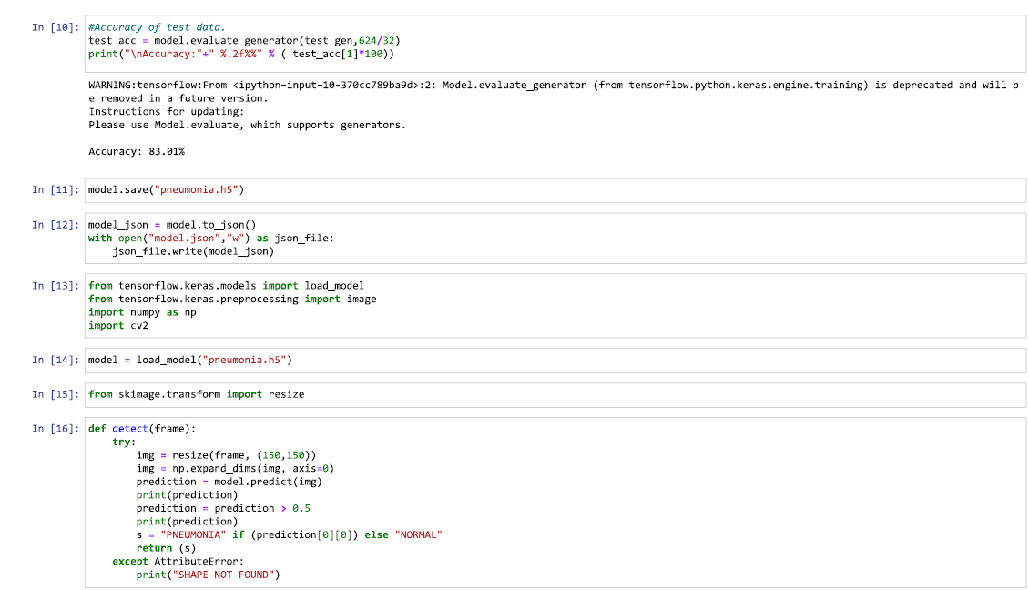

Slide 13
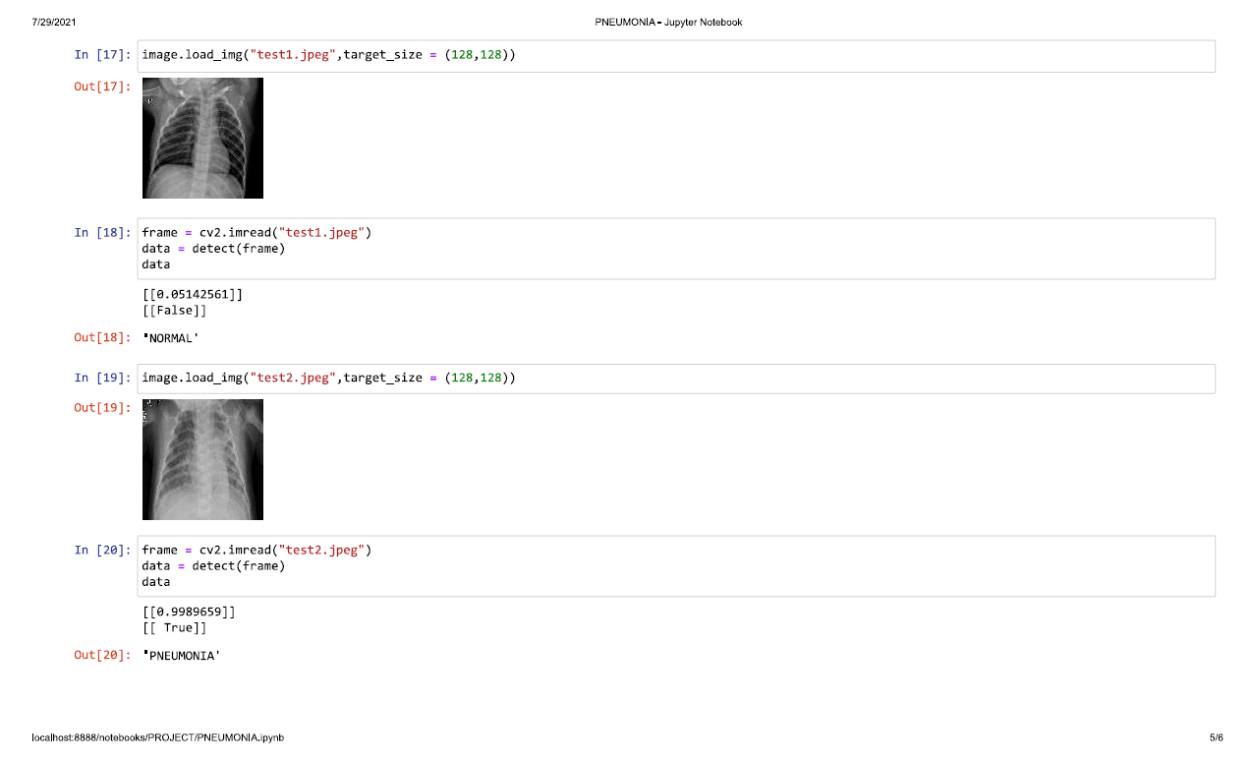

Slide 14
TESTING
TESTING TECHNIQUES USED:
White box testing:
Unit Testing:
Each component of the code is tested individually and made sure that there are no errors and that they are functional.
Integration testing:
After testing each unit, two or more units are combined together and tested to make sure that all the segments are functioning as we intended.

Slide 15
Black box testing:
System Testing
The whole integrated system is tested to make sure that it meets the requirements without knowing the internal structure of the code.
Compatibility Testing
The entire code is tested in different environments like Spyder etc to check if it is functioning.

Slide 16
PERFORMANCE TESTING
Stress testing - The code was tested under extreme workloads to see how it handles high traffic.
Endurance testing - The code is tested to check if it can handle the expected load over a long period of time.
Load testing- the entire code is tested to determine whether it can handle expected consumer load

Slide 17
CONCLUSION
The following is the conclusion of our project:
Unsolved problem that is as of now tormenting the doctors around the world. Our proposed model is designed and advancement to detect and classify pneumonia from chest X-ray pictures. It contains both image processing and convolutional neural network. We developed a model; the algorithm starts by transforming chest X-ray images into sizes less than the original.

Slide 18
The next step includes the identiﬁcation and classiﬁcation of pictures by the convectional neural network structure, which extracts features from the image and classify them.
This work has presented the X-Ray images for Pneumonia discovery based on convolutional neural networks and diverse machine learning. By training a bunch of solid CNNs for an enormous scope dataset, we built a model that can precisely predict Pneumonia.
During each epoch data is trained again and again to learn the feature of data. The presentation assessment of the model is estimated by utilizing classiﬁcation accuracy and cross-validation.

Slide 19

THANK YOU

